Slide 1
Netflix_Titles Insights
In this dataset I have not filled the dataset or completely remove the missing values because it would decrease the number of content that is released on Netlix.
Here is the link to the dataset I have worked on
= https://www.kaggle.com/datasets/shivamb/netflix-shows

Slide 2
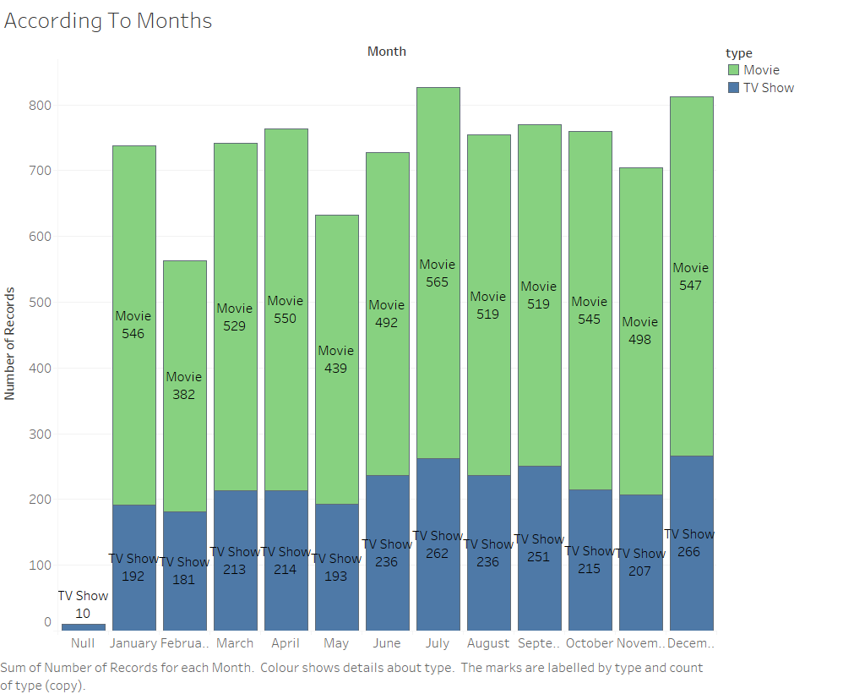
This are the number of movies and tv show that are released in each month from the day of the launch till September 2020

Slide 3
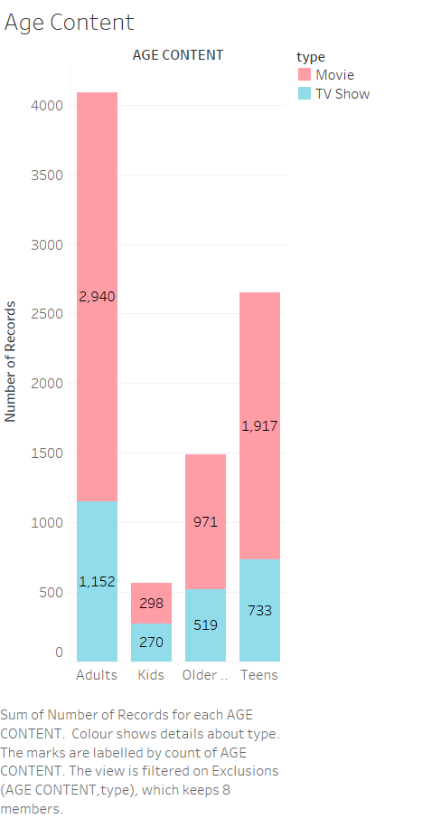
There are more adult Movies and TV Shows on Netflix.

Slide 4
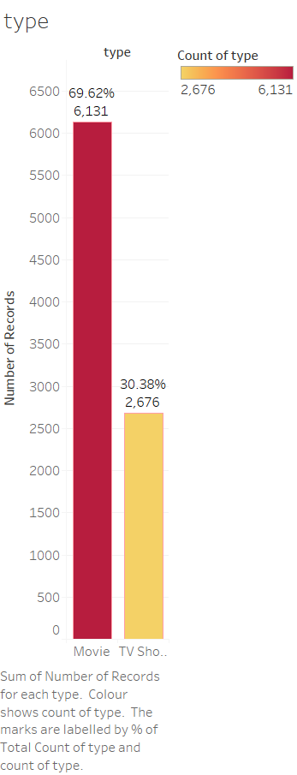
There are More Movies on Netflix as Compared to TV Show.

Slide 5
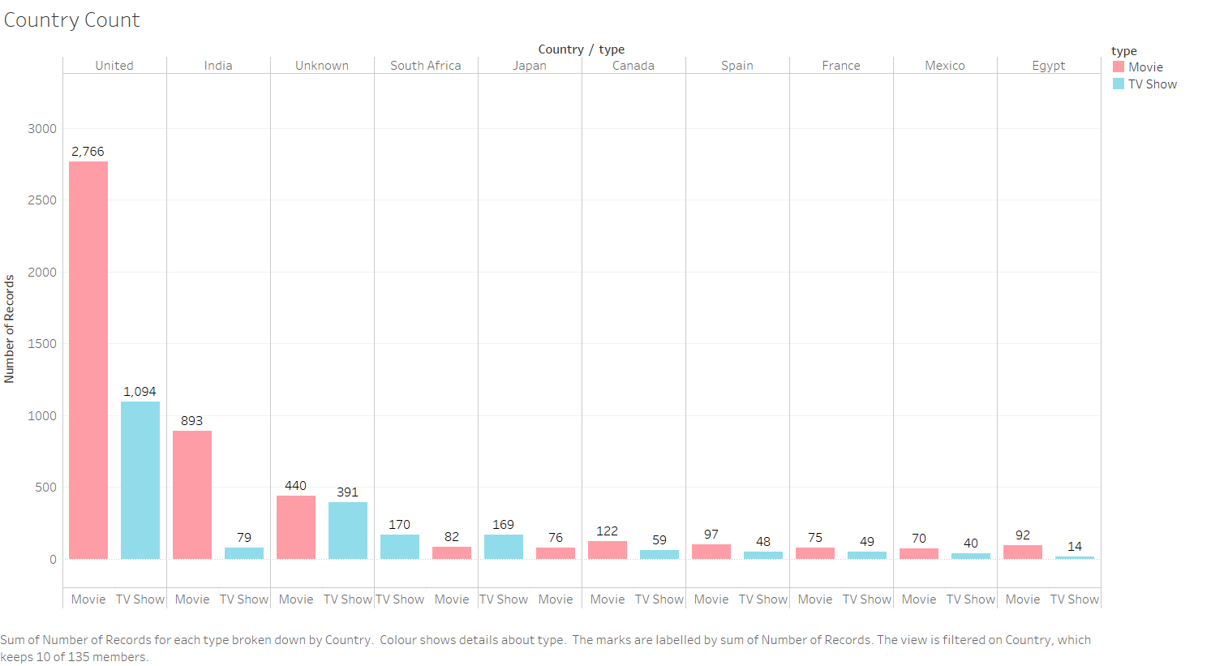
There are more American Movies and TV Shows on Netflix as Compared to Other Countries. Countries Like Japan, Australia, Taiwan, China, Colombia, Singapore have more No. of TV Shows as compared to Movies.

Slide 6
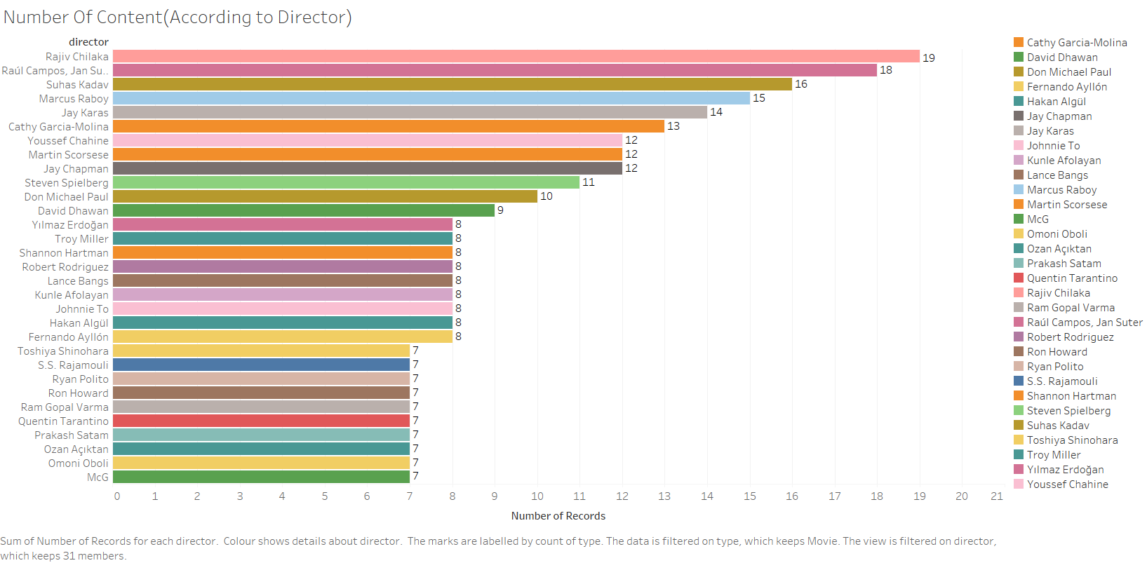
The insight from this graph is that the Rajiv Chilaka has more no. of content on Netflix which belong to Kids Genre.

Slide 7
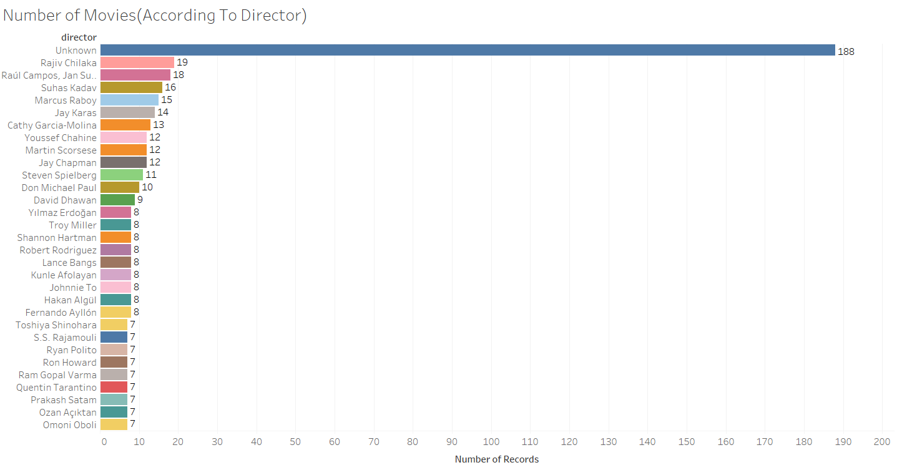
Number of Movies all around the world this directors have on netlfix.

Slide 8
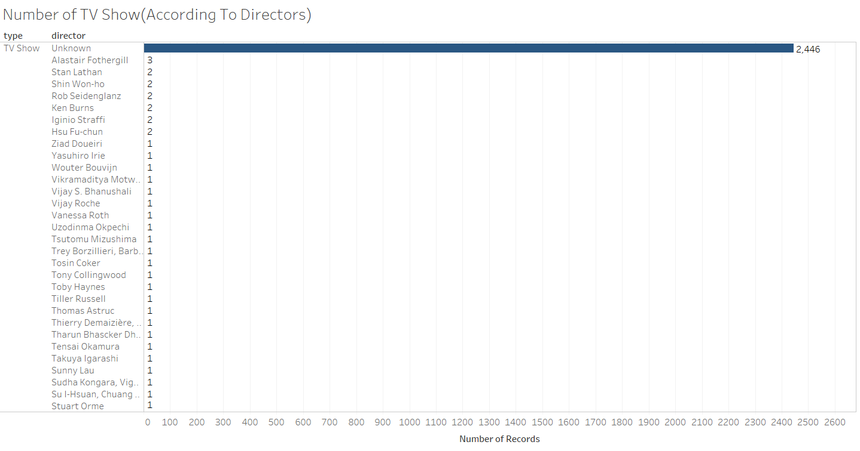
There are less no Of TV Shows directors On Netflix As Compared TO MOvies;.

Slide 9

Lead Actors Collaboration With Other Actors. You can check the Full Collaboration of other actors in Pdf.

Slide 10
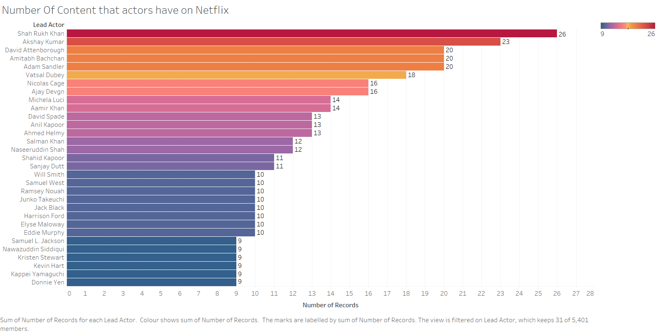
Shah rukh khan has more no. of content on entire Netflix.His content mainly contains movies. David Attenborough Contains both Movies and TV Show on NetFlix.

Slide 11
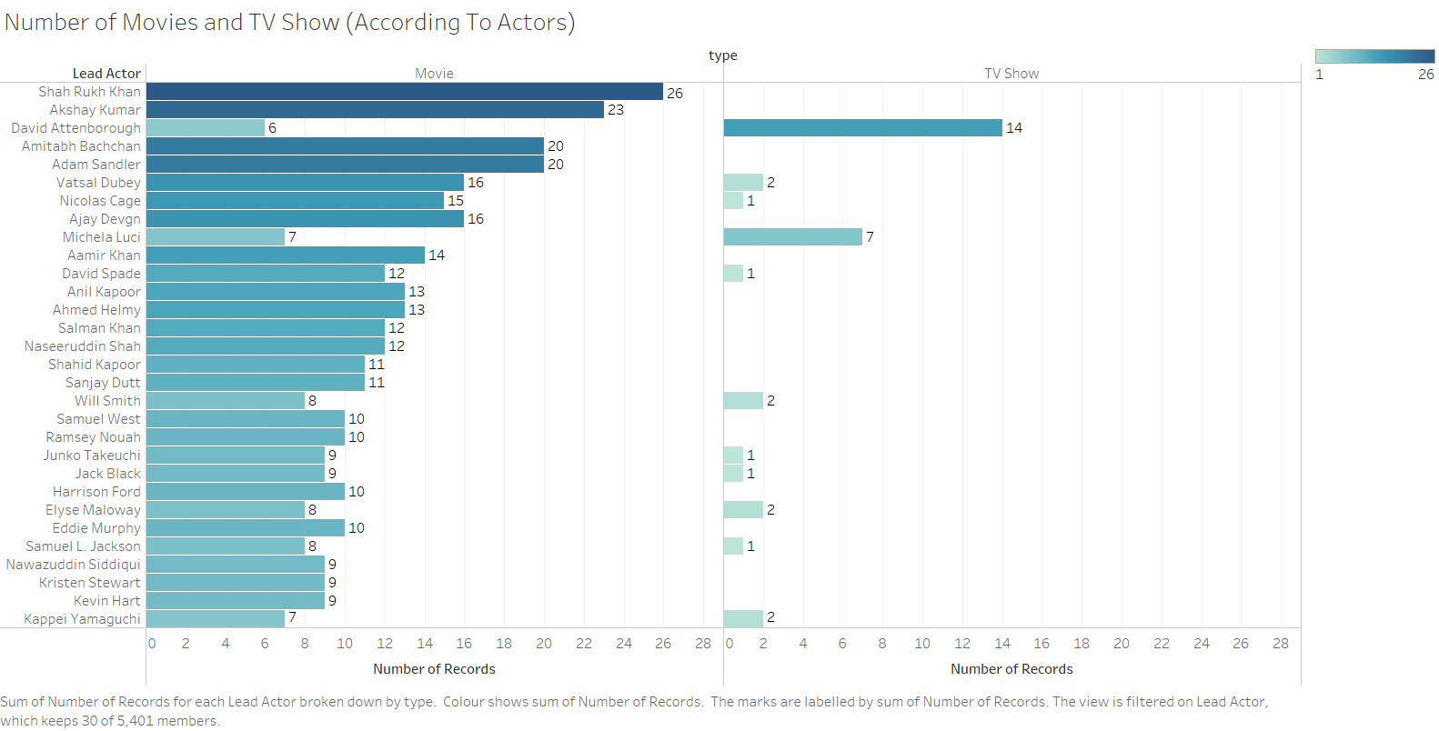
Comparing the content David Attenborough has more no. of TV Shows than any other actor

Slide 12
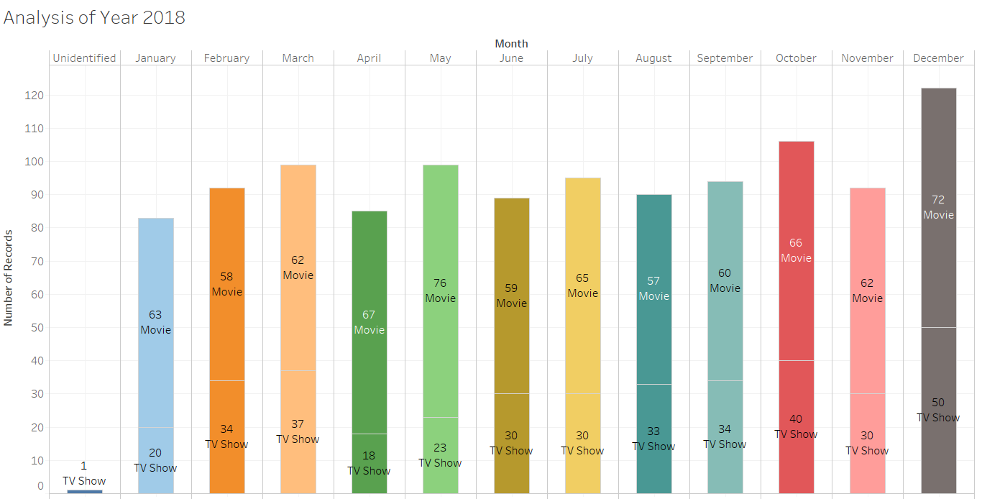
The number of content specifically released in the year 2018.

Slide 13
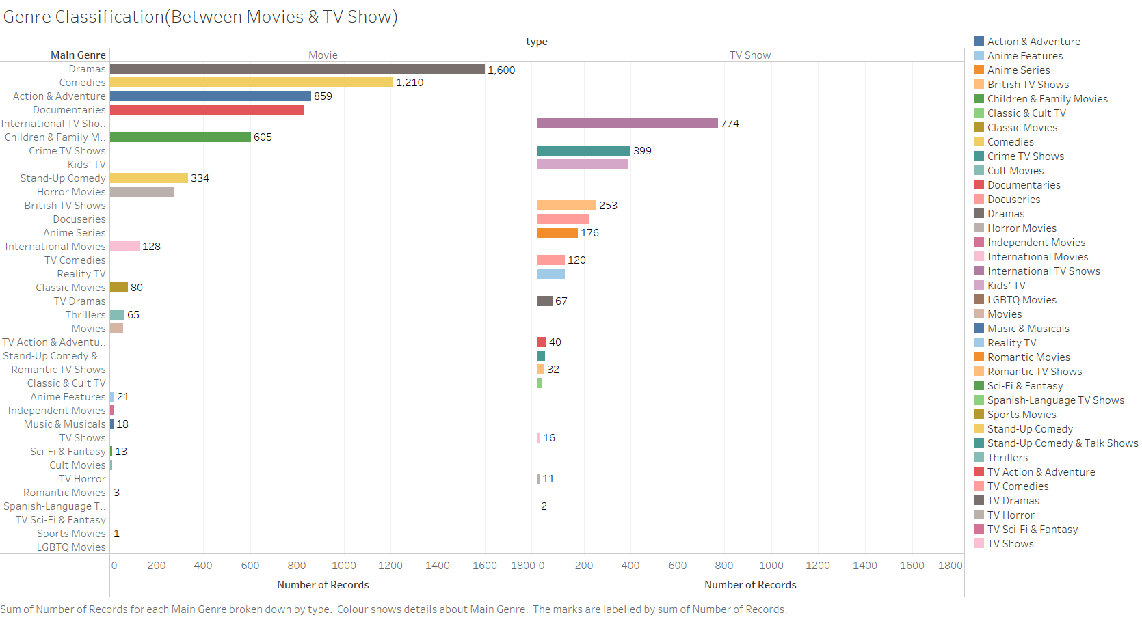
There are more drama genre Movies available on Netflix as compared to comedies.

Slide 14
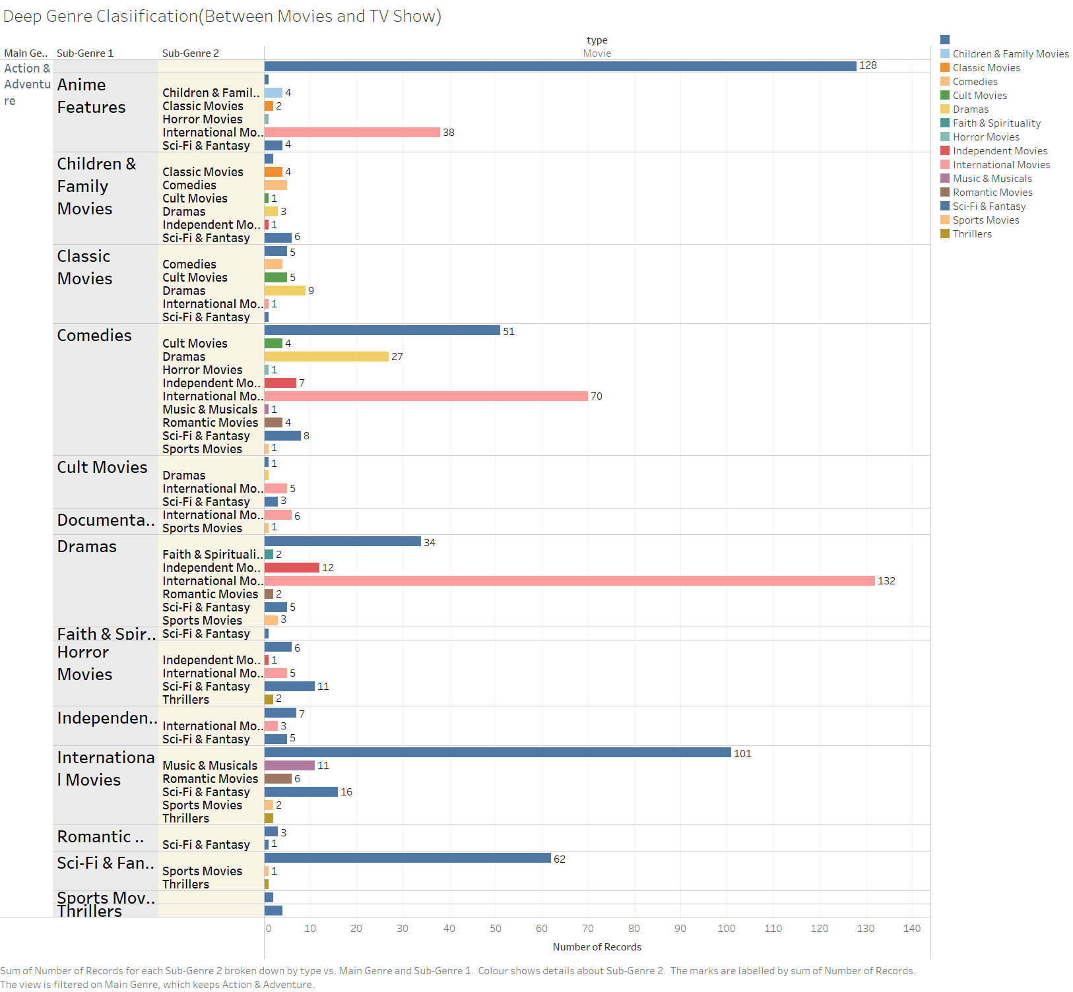
This is more specified Classification of Genre in Movie Section.

Slide 15
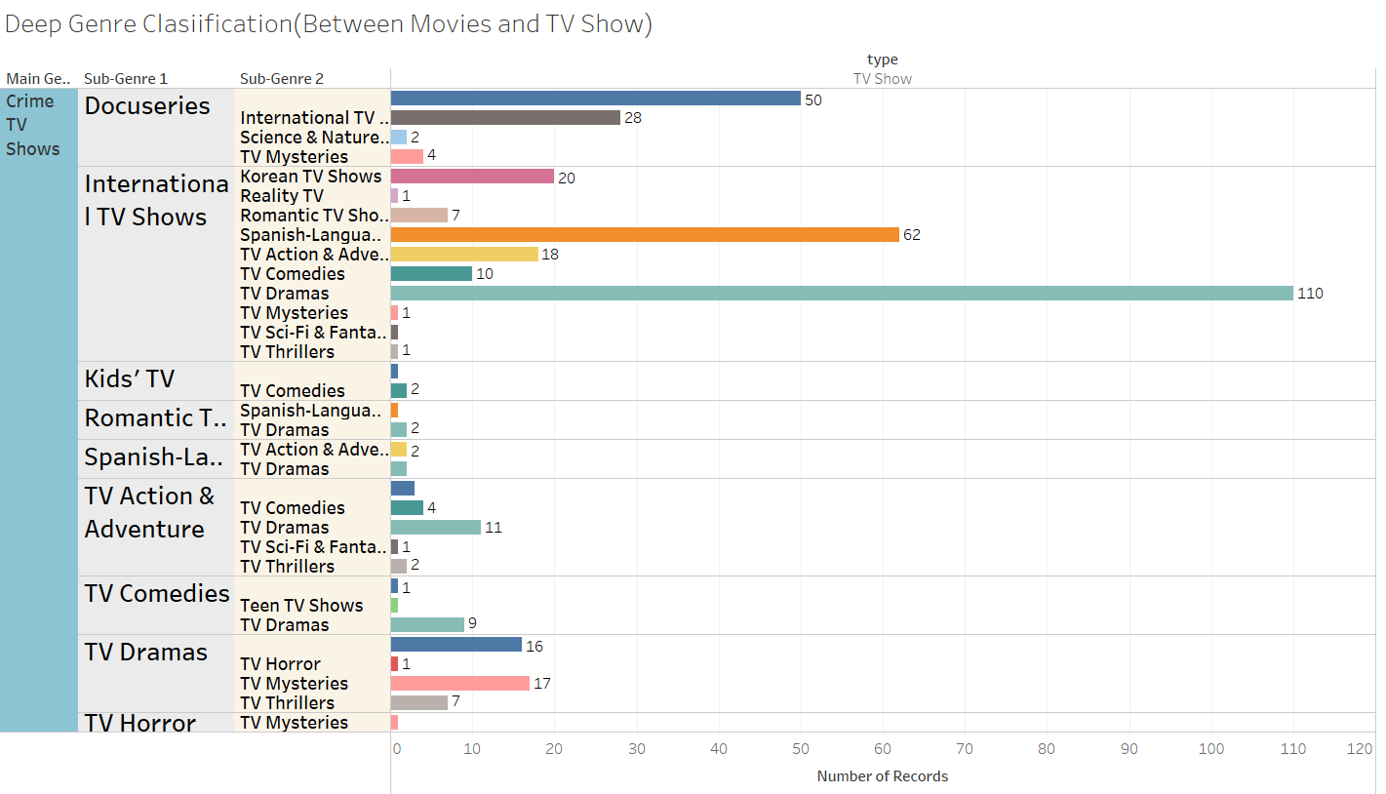
This is more specified Classification of Genre in TV Show Section.

